Slide 1
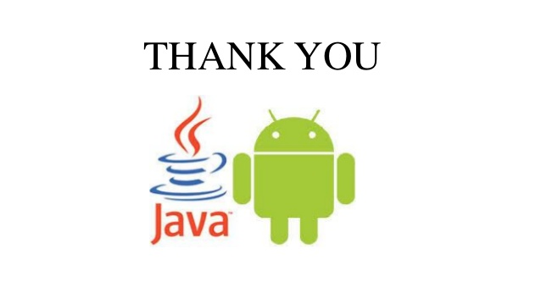


Remote Bluetooth

Slide 2
Contents
INTRDUCTION
How does it works
Advantages and disadvantages
exiting and proposed
system
Future scope
conclusion

Slide 3
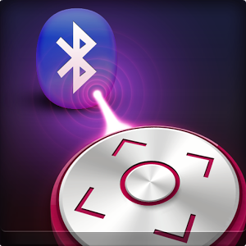
INTRDUCTION What is A Remote Bluetooth
Remote Bluetooth this useful for controlling the Pc via Bluetooth connectivity within the limited distance.
In this application mainly there are two Parts android and java. In this application.
Client side is android and server side is java.

Slide 4
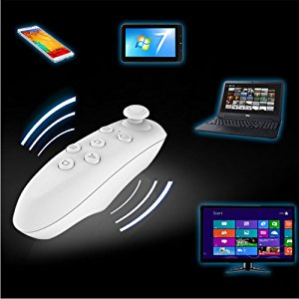
Exiting System
Currently there are different application which controlling the Pc with Bluetooth
For controlling pc separate device is used and in that it contend only four arrow keys are up, down, right, left.

Slide 5
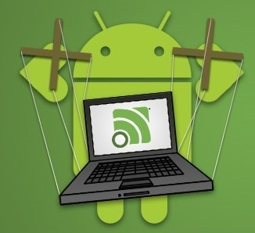
Proposed system
Bluetooth is user friendly it is made as the android app it support for the android higher version it support.
Our project main the feature we can control the pc by giving voice commands.

Slide 6

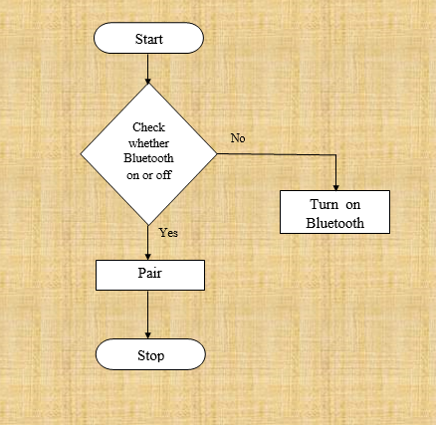

Modules
1.Enable Bluetooth adopter

Slide 7
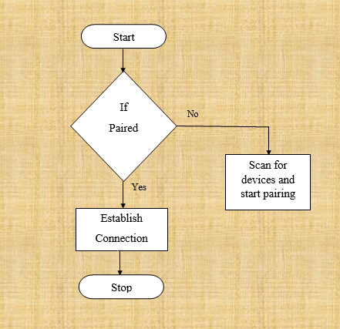
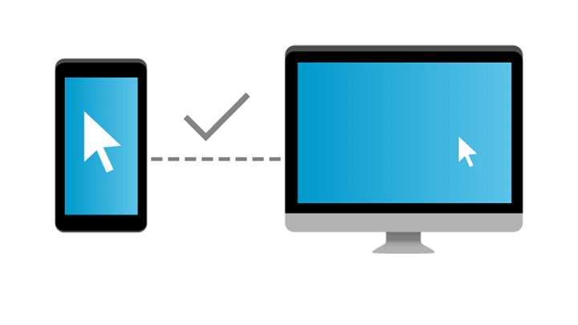
2.Paring with required device

Slide 8
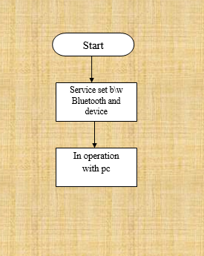
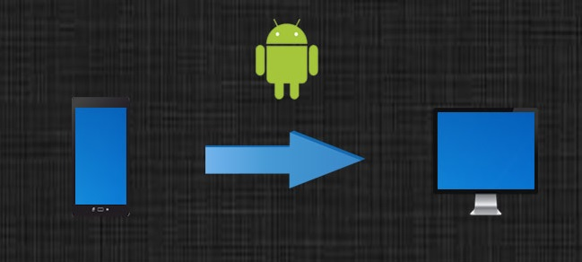
3.Service Setup
between PC and
Mobile

Slide 9
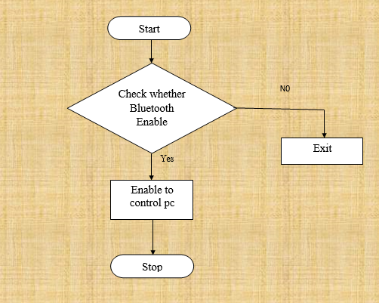

4.Bluetooth adopter in Pc

Slide 10
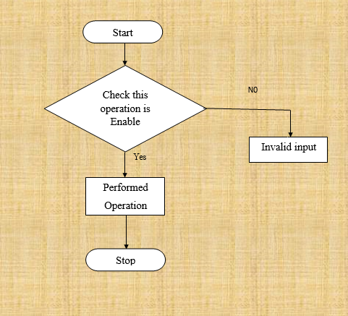
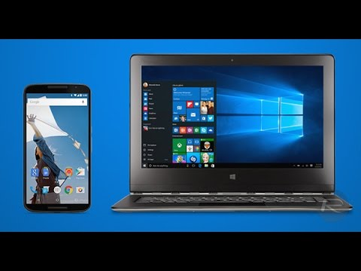
5.Controllig Pc

Slide 11


Advantages
It is used in the meeting hall for giving PPT
It can controlled by voice commands
It is easily connect with the Pc
In this we can do the cut the file, copy the file and paste the file
It is support for the lower version of android device
It is support for the higher version of android device
It can controlled from 50m distance

Slide 12

disadvantages
For voice controller internet need
Limited bandwidth range
There no button for back operation

Slide 13

FUTURE ENHANCEMENT
In Future by this project we can add any other operations like alt, ctrl buttons.
And in the android device we can made the keyboard.
We can connect phone to phone for communication by the Bluetooth with in building by without any internet connection.

Slide 14
CONCLUsION
Here by conclude that, our system is advanced system that has over come all draw back of existing system.
By providing such as voice service we can control the pc by voice and we can perform cut, copy, paste, operation easily.

Slide 15
Thank you

